Slide 1
Unit 4
Atomic Structure
Part I: History of Atomic Theory

Slide 2
Section 1
Developing the Theory of Matter
Based on Atoms

Slide 3
History of the Atom
The understanding of matter has been a source of interest for humans for as long as history has been kept.
Theories of what we and all things are made of have included the likely to the absurd.
The main difference between all of the theories has been dependent upon the current levels of science and technology.
As we should understand, SCIENCE, our system of knowledge for how the universe works and how we acquire new knowledge, IS INTERCONNECTED WITH TECHNOLOGY.
Meaning, our understanding of the world is limited to the sophistication of the tools we use draw conclusions and to access facts.

Slide 4
Where we’re going…
Over the next few weeks you are going to learn everything you can about atoms and elements.
We’ll first discuss the history of the atom, then the structure, finally modern atomic theory.
In later lessons we’ll discuss the periodic table; the logic behind its construction and the properties of elements we observe.

Slide 5
Atomic Structure
  Objectives:
    Research and learn how the theory of atoms have developed over time.
    Describe ancient Greek Models of matter.
    List the main points of Daltons atomic theory and describe evidence for the existence of atoms.
    Explain how Thompson and Rutherford used data from experiments to produce their atomic models.
    Understand the input from Bohr and Schrödinger in how we currently know how an atom is constructed.

Slide 6
Part I
Clash of the Titans. Video Research
You picked up a handout today that has several scientists featured. These scientists are important to study for a few reasons.
First, you hopefully gain an appreciation for the hard work, sacrifice, and challenge it is to bring new information into the world.
Second, the stories of these scientists help to justify taking a cautious approach to what you believe as fact.
One day facts are likely to be proven false.

Slide 7
Part I
Clash of the Titans. Video Research
All you have to do is fill out this chart with as much information as possible.
You will use this as research when establishing a timeline for the theory of the atom in an upcoming assignment.
Listen closely for the names of the scientists involved. They kinda come in order, but a few are mentioned throughout.
Enjoy.

Slide 8
The Theory of the Atom: Clash of the Titans. To start your research into the discovery of the atom you will view this documentary. In this video, the host explains some of the more important scientists and their contribution. You’ll notice that the progression of this idea has been met with a significant amount of controversy. Think about this as you watch; was this process and easy one? Did the scientists featured have an easy time convincing their colleagues?
Scientist: |  | What Year? | Summarize this scientist’s theory and… Explain some of the challenges (personal and/or professional) this scientist faced and Answer or complete any specific questions asked.
Ludwig Boltzmann (2:00-6:00) |  |  | Theory: Challenges:
(3:55) | Why was the discovery of the atom, whether it was “real or not”, so important? What was the driving force?
Albert Einstein (6:20-11:00) |  |  | Theory: Challenges: (8:10) Which theory did Einstein write about that inspired the discovery of the atom? (8:40) What is “Brownian Motion”?
Ernest Rutherford (12:00→) |  |  | Theory: Challenges: (14:40-17:00) Describe the correlation between phenomenon, such as radioactivity and X-rays, and atomic theory. (19:30) What did Rutherford show the world?
Niels Bohr (24:00→) |  |  | Theory: Challenges: (28:50) Did Bohr and Einstein get along? (26:00) Summarize what Bohr’s “Quantum Jump” describes.
Werner Heisenberg (30:00→) |  |  | Theory: Challenges: (40:00) According to Heisenberg, why can’t “an atom be visualized and understood”? (40:50) This is called the Heisenberg ___________________ Principle.
Erwin Schrödinger (31:00→) |  |  | Theory: Challenges:
Summary |  | Who was declared triumphant in the journey to illustrate the atom’s true properties? Have we, any human being, ever seen an atom? Why do we trust that they are there?

Slide 9
  Discovery Assignment
  Atomic Theory Time-line
  Directions. Complete the worksheet, using your books for reference. Discover the year, the scientist’s theory, what this scientist’s evidence, the logic used, was for creating this theory, what the model’s name is, and finally draw the model.
Scientist | Year | Theory/ Contribution to the atom model | Evidence | Model | Drawing
Democritus
Aristotle
Dalton
Thomson
Rutherford
Bohr
Schrödinger

Slide 10
Atomic Structure
  Objectives:
    Research and learn how the theory of atoms have developed over time.
    Describe ancient Greek Models of matter.
    List the main points of Dalton’s atomic theory and describe evidence for the existence of atoms.
    Explain how Thompson and Rutherford used data from experiments to produce their atomic models.
    Understand the input from Bohr and Schrödinger in how we currently know how an atom is constructed.

Slide 11
Ancient Greek Models
The first theories advanced to explain what matter was came from Greek philosophers using mere philosophy and observation. This is known as empirical science.
  600 B.C. Thales: believed everything’s made of water
  500 B.C. Xenophanes: everything’s made of water & earth.
  440 B.C. Empedocles: suggested there were 4 elements; earth, water, air & fire (borrowed from Buddhist theories of the 4 bhūtas) and everything was a combination if these.
  400 B.C. Democritus: Many different elements with a limit to how small you could go.
  340 B.C. Aristotle: 4 elements with no limit to how much they could be split but they could transform into each other.

Slide 12
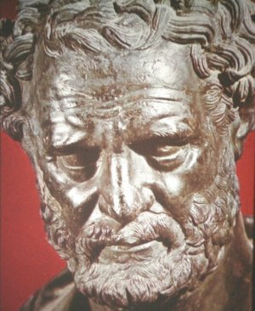
Atomic Structure
Ancient Greek Models of Atoms
  Democritus (400 B.C.)
    All matter could be broken down into very small particles that could not be split.
    He called the particles “atoms” from the Greek word atomos, which means ‘uncut’
    He thought there were different types of atoms based on the substance’s properties.
    His theories were based on logic & observation

Slide 13

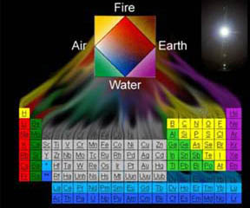
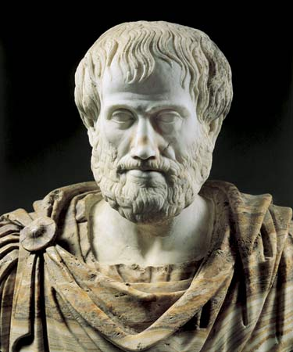
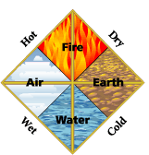
Atomic Structure
Aristotle
  Contrary to Democritus, he believed all matter could be divided over and over into the same four elements.
  There were 4 elements: fire, air, earth and water.
  The elements had combinations of 4 qualities: hot, cold, dry, and wet
  There was a 5th…the stuff that makes up the heavens & spirit that could turn anything into gold.
  This lead to the study of alchemy… a 2,000 year hunt for a nonexistent formula for gold.

Slide 14
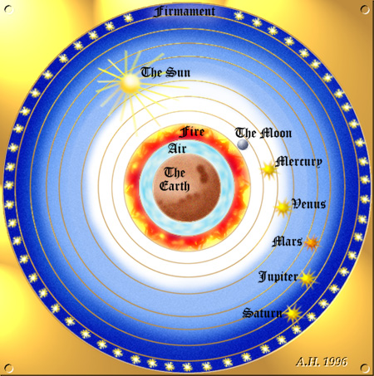
The Atomic Theory’s Dark Ages…
The geo-centric, neo-centric view of atoms, matter, and the universe were perpetuated for thousands of years with the help of religious institutions and bad science.
After the dark ages, scientists began using good science… the scientific method… to discover the truth about matter and atoms.

Slide 15
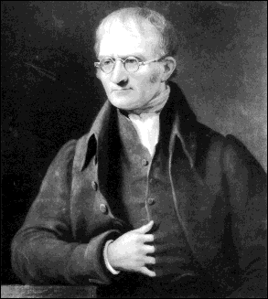
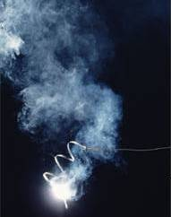
Atomic Structure: Dalton (1805)
Dalton’s Atomic Theory
  Studied behavior of gases.
    Helped formulate gas theories and laws.
  Through his experiments claimed that gas and matter consists of individual particles…like Democritus.
Confirmed Lavoisier’s Law of the Conservation of Matter
  Measured masses of elements that combine when compounds are formed during reactions.
  Noticed that ratio of elements in a compound never changed no matter how much was added.
  Compounds, therefore, have a fixed composition.

Slide 16
Atomic Structure: Dalton’ s Theory
His conclusion…
All matter is made up of individual solids particles called atoms, which cannot be divided.
  All Elements are composed of atoms
  All atoms of the same element have the same mass, and atoms of different elements have different masses.
  Compounds contain atoms of more than one element.
  In a particular compound, atoms of different elements always combine in the same way.

Slide 17

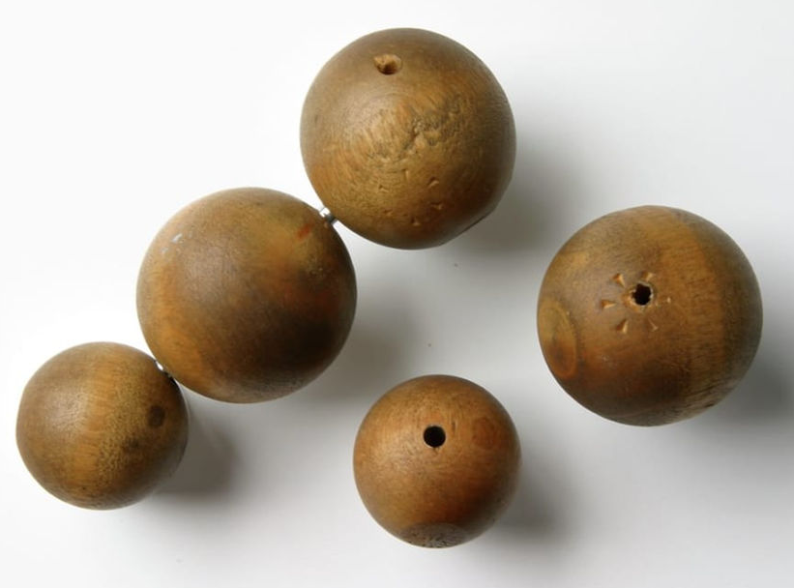
Dalton’s Atomic Model
He believed that atoms were solid.
  His models were solid wooden spheres.
He came to a very sound conclusion but this, as science does, was revised and refined…
What is a model again?
(- Scientific models are physical or mental representation of an object or an event.)

Slide 18
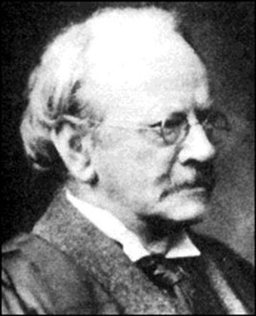
Atomic Structure. Thomson (1897)
Thomson’s Model of the Atom
  At the time of his experiments, it was known that some materials have a positive or negative charge.
What was known at the time...
  Objects with like charges repel, unlike charges attract.
  Electric Current: Some charged particles can flow from one location to another. When charged particles flow it is called an electric current.
  Also known was that atoms were neutral particles.

Slide 19
Atomic Structure
Evidence for Subatomic Particles
  Thomson did experiments to demonstrate that particles came from the inside of atoms.
  Thomson provided first evidence that atoms are made of even smaller particles… electrons… and then the logical opposite, protons.
  This provided some consideration to the possibility that there were smaller particles, other than just the elements, that composed the atom.

Slide 20
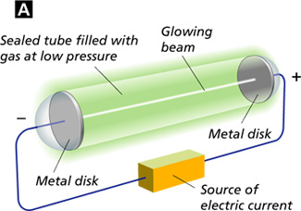
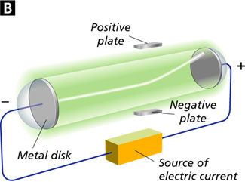
Thomson’s Cathode Ray Experiment
The positively charged plate attracted the negatively charged beam.

Slide 21
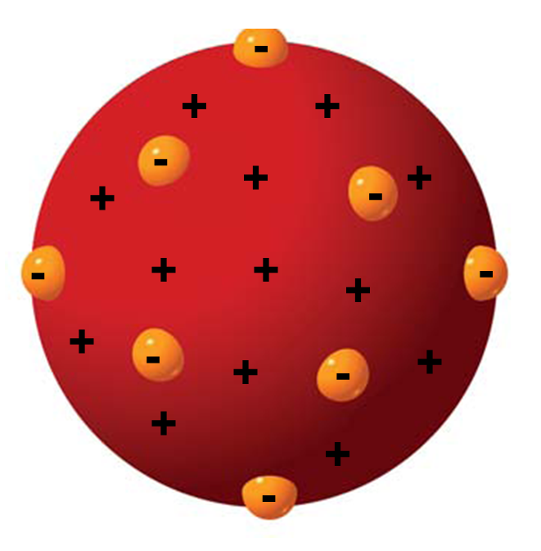
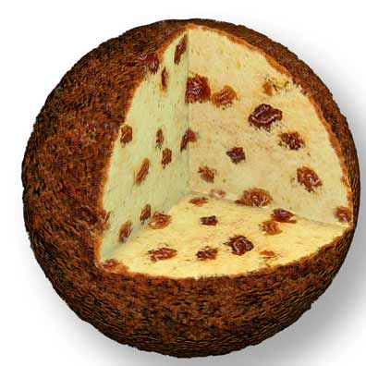
Atomic Structure
Thomson’s Model: Plum Pudding
  Atoms have no overall electrical charge…It’s neutral.
  Thomson’s model scatters negative charges throughout positively charged matter.
  Model is called the “plum pudding” atomic model.
Negatively charged particles in…
positively charged matter

Slide 22
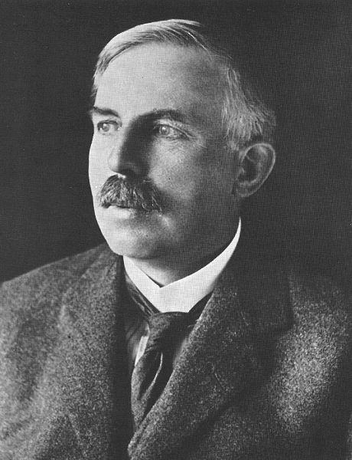
Atomic Structure. Rutherford (1911)
Rutherford’s Atomic Theory
  Ernest Rutherford found that uranium puts out fast-moving particles that are positively charged.
  These positive particles are called alpha particles.
  Rutherford disproved Thomson when he determined that the positive charge of an atom is not evenly spread throughout the atom as previously thought.

Slide 23

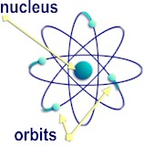
Atomic Structure
Discovery of The Nucleus
  Rutherford suggested the positive charges were concentrated in the central part of the atom.
  He called it the nucleus.
The nucleus is in the center,
it is a dense area in the center,
it has mass and has a positive charge.
All of an atom’s positive charge
is concentrated in the nucleus.

Slide 24
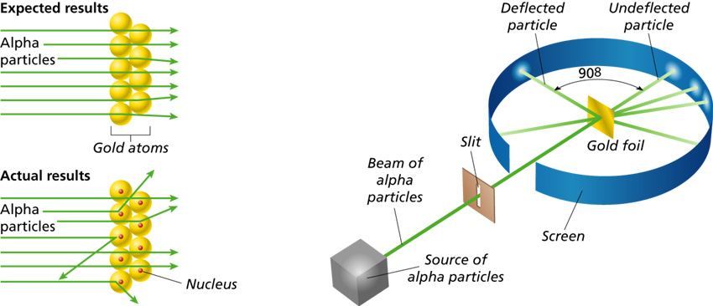
Rutherford’s “Gold Foil” Experiment… How he did it
Isolated particles moving
directly at the gold foil

Slide 25

Rutherford’s Experiment
+
What was predicted… if Thompson was right.
What he saw… made Thompson wrong.
+
+
+
+
+
+
+
why?
+
+
+
+
+
Btw. Like charges repel each other
+

Slide 26
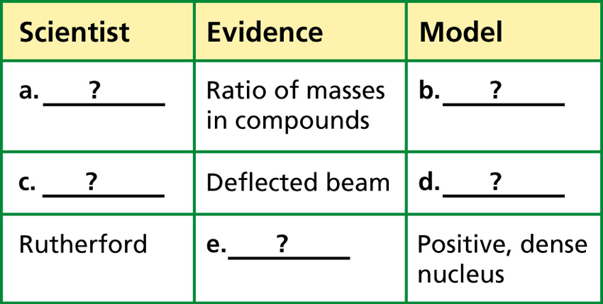
Check your understanding
a. Dalton b. Indivisible, solid spheres
c. Thomson d. Negative charges evenly scattered through a positively charged mass of matter
(plum pudding model)
e. Deflection of alpha particles passing through gold foil

Slide 27
This is the model you know so far…
This is a representation of Rutherford’s model.
It is called the “solar system” model because it placed a nucleus in the center of electrons orbiting around it.
-
-
-
-
+
+
+
+
+
+
-
-
-
-
You are going to learn the newest versions today.

Slide 28
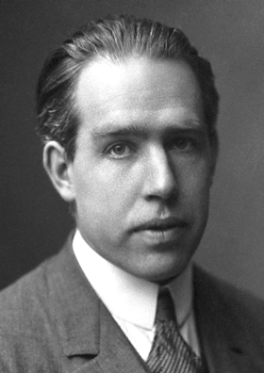
Modern Atomic Theory
Niels Bohr (1913)
To begin to understand how elements behave you need to understand how the electrons are distributed.
To do that let’s look at the man who discovered it.
A contemporary of Rutherford, Niels Bohr (1885-1962) from Denmark discovered something that Rutherford didn’t.
He focused on the negative charges and found the electrons.
He discovered quite a bit more though.

Slide 29

Bohr’s Model of the Atom…
He was first to really focus on where electrons were in relation to the nucleus.
He mathematically proved that the electrons existed in different, particular orbits around the nucleus.
Not just all in the same one or randomly.
The orbital the electron existed in was dependent upon how much energy the electron had.
Bohr’s model looks like a model of the solar system with planets orbiting the sun.
The difference between Bohr’s and Rutherford’s model is Bohr’s places electrons in differing orbits that he called energy levels.

Slide 30
What do you notice about the differences between them?
Bohr’s Model Rutherford Model
Bohr’s is similar to Rutherford’s as it has a nucleus surrounded by space.
The main difference is that Bohr’s model places the electrons in different orbits around the nucleus.

Slide 31
Bohr’s V. Rutherford’s
-
-
-
-
-
-
+
+
+
+
+
+
-
+
+
-
-
+
+
+
+
-
-
-
-
-
-
-
Different Orbits
Same Orbit

Slide 32
Modern Atomic Theory Energy Levels
There are facts about Bohr’s model that you should remember.
  Bohr model places electrons in a specific orbit around the nucleus based upon their energies.
    The orbits therefore are called energy levels.
  Electrons move with constant speed within their particular orbital based upon their energy.
  When an atom gains or loses energy, (such as being heated or cooled) the energy of the electron changes.
  When energy changes the electrons may jump from one energy level to the next, up or down, but cannot exist in-between.

Slide 33
Bohr’s Model & The Introduction of Energy
Energy (Heat)
Energy (Heat)
Energy (Heat)
-
-
-
-
+
+
+
+
+
+
-
-
-
-

Slide 34
Energy Levels…The Proof
The proof of the multiple energy levels is evident when considering the measured energy inputs and outputs.
Scientists can record how much energy is given to an atom.
The energy is absorbed by the atom for awhile.
The atom will then give that energy back to the environment as it cools.
The energy can be measured as it’s released but interesting things also happen.
Atoms can emit light while the electrons are moving down energy levels, as the atom’s losing energy.

Slide 35
Bohr’s Model & The Release of Energy
Sometimes the atom simply releases energy and becomes more stable
Energy (Heat)
-
-
-
Energy (Heat)
-
+
+
+
+
+
+
-
-
Energy (Heat)
-
-

Slide 36
Bohr’s Model & The Release of Energy
Light
Light
Light
Sometimes the atom emits light as it releases energy
Energy (Heat)
Light
-
-
Light
-
Energy (Heat)
-
+
+
+
+
+
+
-
Light
-
Light
Energy (Heat)
-
-
Light

Slide 37
Modern Atomic Theory
Bohr’s model was correct about one specific thing.
That electrons move in different energy levels.
He was challenged on proving the consistency in which they move.
His theory was supplemented by other scientists, namely Schrödinger, until the latest and most widely accepted model of the atom existed.
The Electron Cloud Model

Slide 38
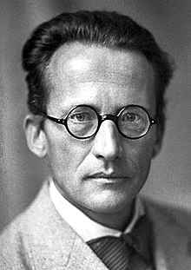
Schrödinger (1926)
By the time Bohr and his protégé Heisenberg, were completing their theory based on Quantum Mechanics, it had gained enough popularity that critics were challenging it.
Schrödinger couldn’t accept all of Bohr’s theory.
He used probabilities to generate a next generation interpretation of Bohr’s model, that took into account the fact that no one could ever know both the location and speed of an electron.

Slide 39
Schrödinger
Can you identify where the electron is?
+
+
+
+
+
+

Slide 40
The Electron Cloud Model
Schrödinger’s electron cloud model suggests that the location of an electron can’t be really predicted; only the probability of the likelihood an electron would be there.
  Probability is used to determine where an electron is likely to be at any particular moment in time.
  What is probability?
The problem with Schrödinger’s model is that there hasn’t been any 3-D model that can express probability accurately, maybe it just can’t be done.
The most acceptable model represents the probability of an electron being in any area by regions being more heavily shaded when there is a higher chance of an electron being there.
The model that we use to represent an atom, therefore, is a combination of Bohr’s Orbital Model and Schrödinger’s Electron Cloud model.

Slide 41
The Electron Cloud/Bohr Model
The Electron Cloud Model
The Bohr Model
Ultimately, scientists use the electron cloud theory with Bohr’s orbitals to describe the possible locations of electrons around the nucleus, using probability.
Electrons are there, but they don’t really have to be there.

Slide 42
Let’s Review the History of the Atomic Model
Dalton
  Solid Sphere
  1803

Slide 43
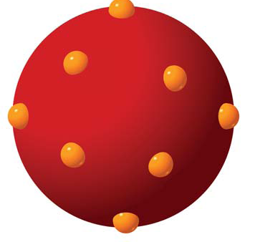
The Evolution of the Atomic Model
-
+
+
-
+
-
+
+
-
+
+
-
+
+
-
+
-
+
+
+
-
Thomson Model
  Plum Pudding
  1897

Slide 44
The Evolution of the Atomic Model
Rutherford Model
  Nucleus & Orbitals
  1911

Slide 45
The Evolution of the Atomic Model
Bohr
  Electrons in Separate Orbitals
  1913

Slide 46
The Evolution of the Atomic Model
Schrödinger
  Electron Cloud
  1926
This, along with Bohr’s model, it the one that is used today.

Slide 47
Schrödinger
Can you identify where the electron is?
+
+
+
+
+
+

Slide 48
Modern Atomic Theory
Atomic Orbitals
  Schrödinger’s electron cloud, based upon his famous Wave Equation, is a good approximation of how electrons behave in their orbitals.
  However, it’s easier to discuss atomic and electron behaviors when using Bohr’s model.
  For that reason we will use Bohr’s model to help explain the behaviors of electrons from now on out.

Slide 49
The Complete Atomic Model
Bohr Models
  The most widely accepted theory on the construction of an atom used to illustrate the characteristics of electron behavior…

Slide 50
Section 1 Quiz:
What did Aristotle say about matter?
What did Democritus say about matter?
How did their opinions differ?
Draw on a sheet of paper the models for…
  Dalton
  Thompson
  Rutherford
Describe what each of these three claimed about matter and atoms.

